Slide 1
Bottom-up parsing

Slide 2
Top-Down Parsing:
Start at the root of the tree and grow towards leaves.
Pick a production and try to match the input.
We may need to backtrack if a bad choice is made.
Some grammars are backtrack-free (predictive parsing).

Slide 3
Bottom-Up Parsing
Goal: Given a grammar, G, construct a parse tree for a string (i.e., sentence) by starting at the leaves and working to the root (i.e., by working from the input sentence back toward the start symbol S).
Recall: the point of parsing is to construct a derivation:
S⇒δ₀⇒δ₁⇒δ₂⇒...⇒δ_{n-1}⇒sentence
To derive δ_{i-1} from δ_{i}, we match some rhs b in δ_{i}, then replace b with its corresponding lhs, A. This is called a reduction (it assumes A→b).
The parse tree is the result of the tokens and the reductions.

Slide 4
Example:
Consider the grammar below and the input string abbcde.
1. Goal→aABe
2. A→Abc
3. |b
4. B→d

Slide 5
Example:
Consider the grammar below and the input string abbcbcde.
1. Goal→aABe
2. A→Abc
3. |b
4. B→d

Slide 6
Input string: abcde
1. Goal→ABB
2. A→Abc
|b
|a
B→d
|e

Slide 7
Finding Reductions
What are we trying to find?
  A substring b that matches the right-side of a production that occurs as one step in the rightmost derivation. Informally, this substring is called a handle.
Formally, a handle of a right-sentential form δ is a pair <A→b,k> where A→b ∈ P and k is the position in δ of b’s rightmost symbol.
(right-sentential form: a sentential form that occurs in some rightmost derivation).
  Because δ is a right-sentential form, the substring to the right of a handle contains only terminal symbols. Therefore, the parser doesn’t need to scan past the handle.
  If a grammar is unambiguous, then every right-sentential form has a unique handle (sketch of proof by definition: if unambiguous then rightmost derivation is unique; then there is unique production at each step to produce a sentential form; then there is a unique position at which the rule is applied; hence, unique handle).
  If we can find those handles, we can build a derivation!

Slide 8
Motivating Example
Given the grammar of the left-hand side below, find a rightmost derivation for x – 2*y (starting from Goal there is only one, the grammar is not ambiguous!). In each step, identify the handle.
1. Goal → Expr
2. Expr → Expr + Term
3. | Expr – Term
4. | Term
5. Term → Term * Factor
6. | Term / Factor
7. | Factor
8. Factor → number
9. | id
Problem: given the sentence x – 2*y, find the handles!

Slide 9
A basic bottom-up parser
The process of discovering a handle is called handle pruning.
To construct a rightmost derivation, apply the simple algorithm:
for i=n to 1, step -1
find the handle <A→b,k>_{i} in δ_{i}
replace b with A to generate δ_{i-1}
(needs 2n steps, where n is the length of the derivation)
One implementation is based on using a stack to hold grammar symbols and an input buffer to hold the string to be parsed. Four operations apply:
  shift: next input is shifted (pushed) onto the top of the stack
  reduce: right-end of the handle is on the top of the stack; locate left-end of the handle within the stack; pop handle off stack and push appropriate non-terminal left-hand-side symbol.
  accept: terminate parsing and signal success.
  error: call an error recovery routine.

Slide 10
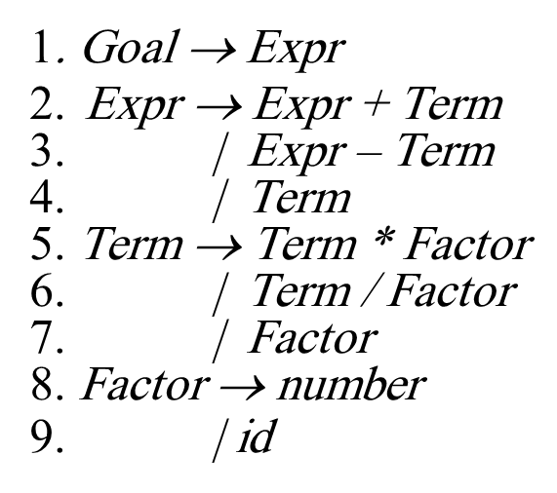
Example: x–2*y
!!
!!
  1. Shift until top of stack is the right end of the handle
  2. Find the left end of the handle and reduce
(5 shifts, 9 reduces, 1 accept)

Slide 11
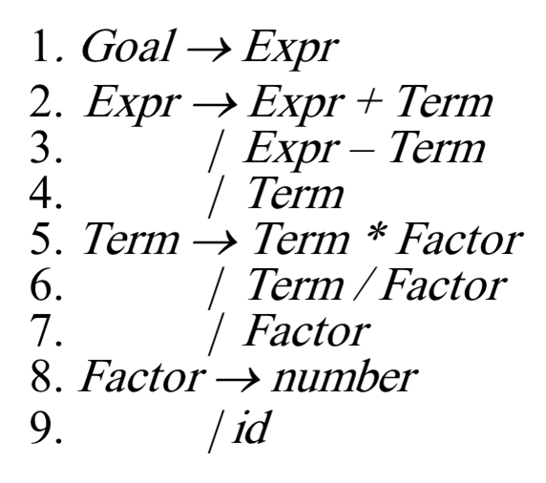
Example: x/4+2*y

Slide 12
What can go wrong?
(think about the steps with an exclamation mark in the previous slide)
Shift/reduce conflicts: the parser cannot decide whether to shift or to reduce.
Example: the dangling-else grammar; usually due to ambiguous grammars.
Solution: a) modify the grammar; b) resolve in favour of a shift.
Reduce/reduce conflicts: the parser cannot decide which of several reductions to make.
Example: id(id,id); reduction is dependent on whether the first id refers to array or function.
May be difficult to tackle.
Key to efficient bottom-up parsing: the handle-finding mechanism.

Slide 13
LR(1) grammars
(a beautiful example of applying theory to solve a complex problem in practice)
A grammar is LR(1) if, given a rightmost derivation, we can:
(I) isolate the handle of each right-sentential form, and
(II) determine the production by which to reduce, by scanning the sentential form from left-to-right, going at most 1 symbol beyond the right-end of the handle.

Slide 14
LR(1) grammars
LR(1) grammars are widely used to construct (automatically) efficient and flexible parsers:
  Virtually all context-free programming language constructs can be expressed in an LR(1) form.
  LR grammars are the most general grammars parsable by a non-backtracking, shift-reduce parser (deterministic CFGs).
  Parsers can be implemented in time proportional to tokens+reductions.
  LR parsers detect an error as soon as possible in a left-to-right scan of the input.
L stands for left-to-right scanning of the input; R for constructing a rightmost derivation in reverse; 1 for the number of input symbols for lookahead.

Slide 15
LR Parsing: Background
Read tokens from an input buffer (same as with shift-reduce parsers)
Add an extra state information after each symbol in the stack. The state summarises the information contained in the stack below it. The stack would look like:
$ S₀ Expr S₁ - S₂ num S₃

Slide 16
LR Parsing: Background
Use a table that consists of two parts:
  action[state_on_top_of_stack, input_symbol]: returns one of: shift s (push a symbol and a state); reduce by a rule; accept; error.
  goto[state_on_top_of_stack,non_terminal_symbol]: returns a new state to push onto the stack after a reduction.

Slide 17
The Big Picture: Prelude to what follows
LR(1) parsers are table-driven, shift-reduce parsers that use a limited right context for handle recognition.
They can be built by hand; perfect to automate too!
Summary: Bottom-up parsing is more powerful!
source
code
Scanner
Table-driven
Parser
I.R.
tokens
The table encodes
grammatical knowledge
It is used to determine
the shift-reduce parsing
decision.
grammar
Parser
Generator
Table

Slide 18
Example
Consider the following grammar and tables:
1. Goal → CatNoise
2. CatNoise → CatNoise miau
3. | miau
Example 1: (input string miau)
Example 2: (input string miau miau)
Note that there cannot
be a syntax error with
CatNoise, because it has
only 1 terminal symbol.
“miau woof” is a lexical
problem, not a syntax
error!
eof is a convention for end-of-file (=end of input)

Slide 19
Example: the expression grammar
1. Goal → s0Expr s1
2. Expr → s0Expr s1+ s6Term s10
3. | s0Expr s1– s7Term s11
4. | s0Term s2
5. Term → s0Term s2 * s8Factor s12
6. | s0Term s2 / s9Factor s13
7. | s0Factor s3
8. Factor → s0number s4
9. | s0id s5

Slide 20
Example: the expression grammar
1. Goal → Expr
2. Expr → Expr + Term
3. | Expr – Term
4. | Term
5. Term → Term * Factor
6. | Term / Factor
7. | Factor
8. Factor → number
9. | id
Parse: a) X+2*Y
b)X/4 – Y*5

Slide 21
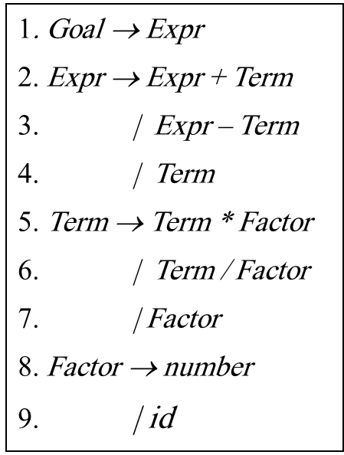
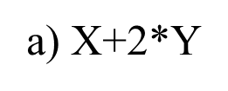

Slide 22
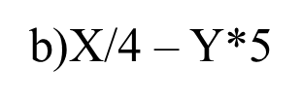
Stack | Input | Action
$s0 | X/4-Y*5 | S5
$s0Xs5 | /4-Y*5 | R9
$s0FactorS3 | /4-Y*5 | R7
$s0TermS2 | /4-Y*5 | S9
$S0TermS2/S9 | 4-Y*5 | S4
$S0TermS2/S94S4 | -Y*5 | R8
$S0TermS2/S9FactorS13 | -Y*5 | R6
$S0TermS2 | -Y*5 | R4
$S0ExprS1 | -Y*5 | S7
$S0ExprS1-S7 | Y*5 | S5
$S0ExprS1-S7YS5 | *5 | R9
$S0ExprS1-S7FactorS3 | *5 | R7
$S0ExprS1-S7TermS2 | *5 | S8
$S0ExprS1-S7TermS2*S8 | 5 | S4
$S0ExprS1-S7TermS2*S85S4 | Eof | R8
$S0ExprS1-S7TermS2*S8FactorS12 | Eof | R5
$S0ExprS1-S7TermS11 | Eof | R3
$S0ExprS1 | Eof | Acc

Slide 23
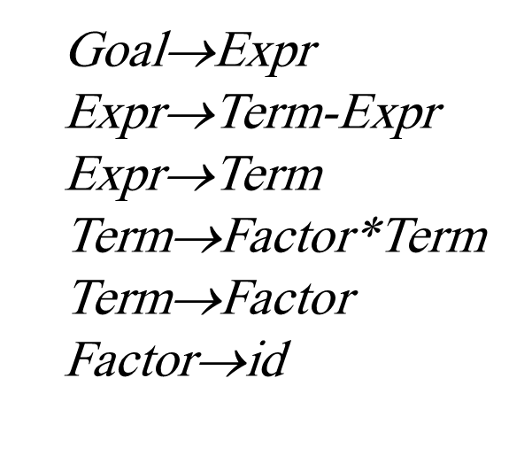
Example:

Slide 24
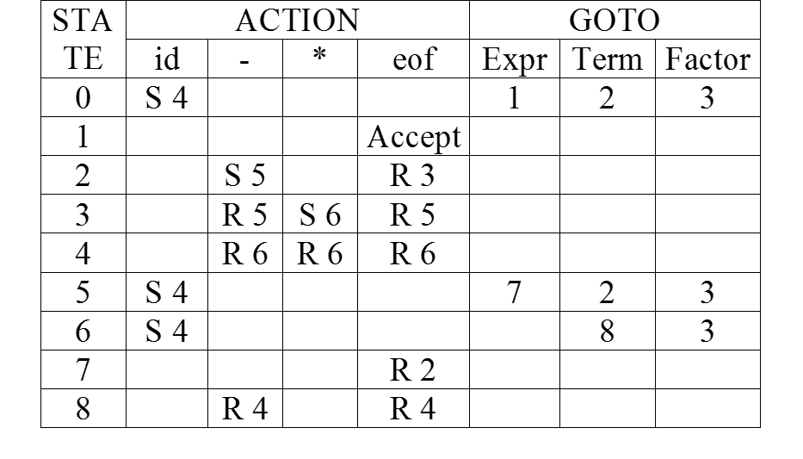
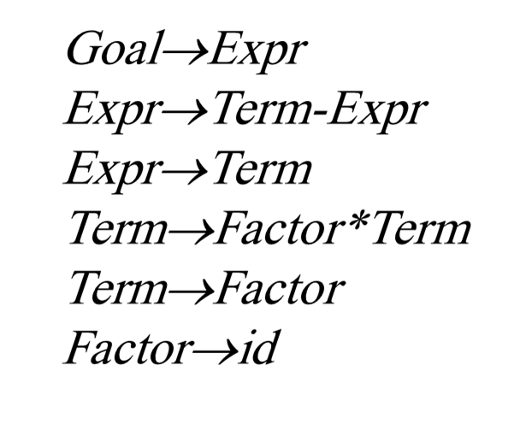
X – Y *5

Slide 25
X - Y /5

Slide 26
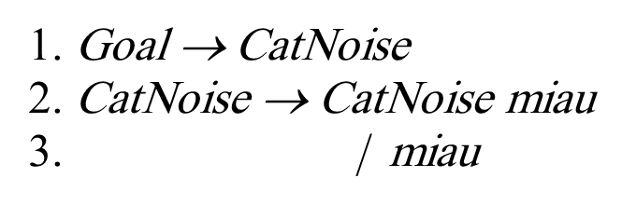
Example : LR(1) Table Generation

Slide 27
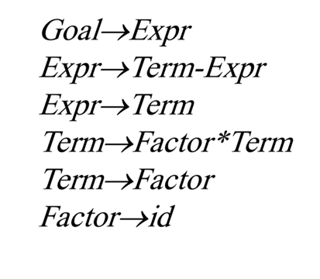
Example : LR(1) Table Generation

Slide 28
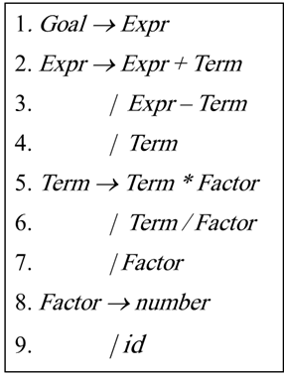

Slide 29
Summary
Top-Down Recursive Descent: Pros: Fast, Good locality, Simple, good error-handling. Cons: Hand-coded, high-maintenance.
LR(1): Pros: Fast, deterministic languages, automatable. Cons: large working sets, poor error messages.
What is left to study?
  Checking for context-sensitive properties
  Laying out the abstractions for programs & procedures.
  Generating code for the target machine.
  Generating good code for the target machine.

